Slide 1
CHATTING APPLICATION
SHIVAJIRAO S. JONDHALE COLLEGE OF ENGINEERING DOMBIVLI.
JAVA PROJECT
SECOND YEAR (SEM-3)
INFORMATION TECHNOLOGY

Slide 2
TOPIC:- Chatting Application using Java
PREPARED BY:
GUIDED BY:-Prof M.R.Gorbal
NAME | ROLL NO
ACHAREKAR SAYALI ANIL | 01
GARATE ARYAN Arvind | 08
SRIVASTAVA SHRIYANSHI DIPANKAR | 22

Slide 3
CONTENT
TITLE | PAGE NO.
Introduction | 4
Problem Statement | 5
Results | 6
Future Work | 11
Conclusion | 12
References | 13

Slide 4
INTRODUCTION
Chatting is a method of using technology to bring people and ideas “together” despite of the geographical barriers. The technology has been available for years but the acceptance it was quite recent. Our project is an example of a multiple client chat server.
This client server chat application is based on java swing and used socket package. it’s simple and easy and require only core java knowledge.
This application/program is a good example of using java.io, java.net package to create a chat application. A beginner of java language, who is familiar with this package can able, be beneficiate.

Slide 5
Problem Statement
Our project is to create a chat application with a server and users to enable the users to chat with each others. To develop an instant messaging solution to enable users to seamlessly communicate with each other.
Application consists of two programs:
Server
Client

Slide 6
Results

Slide 7
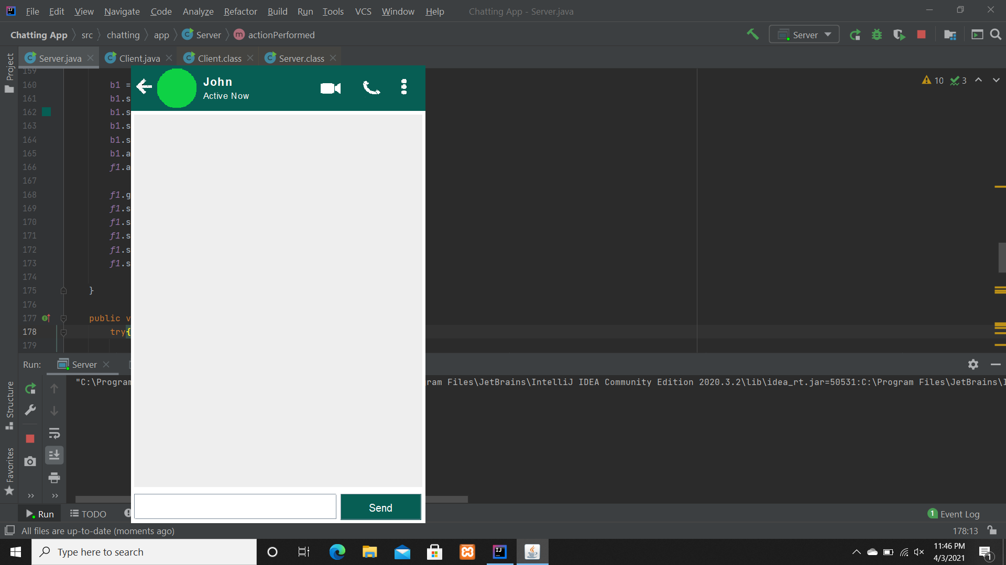
Fig name : The Server Windows

Slide 8
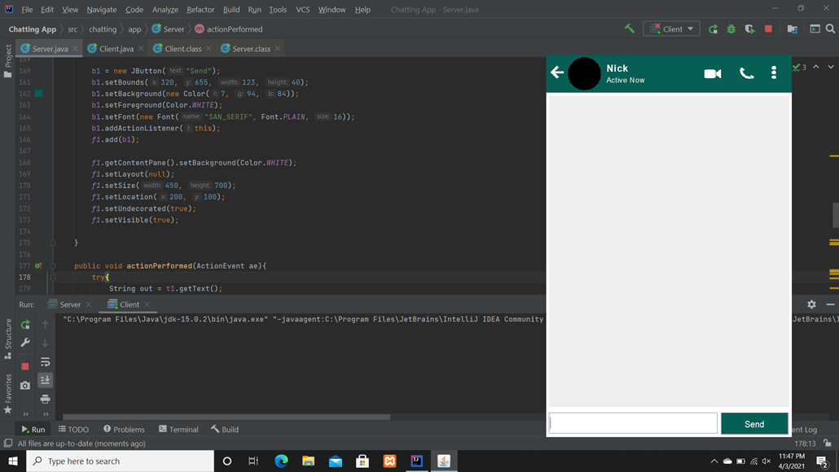
Fig name : The Client Windows

Slide 9
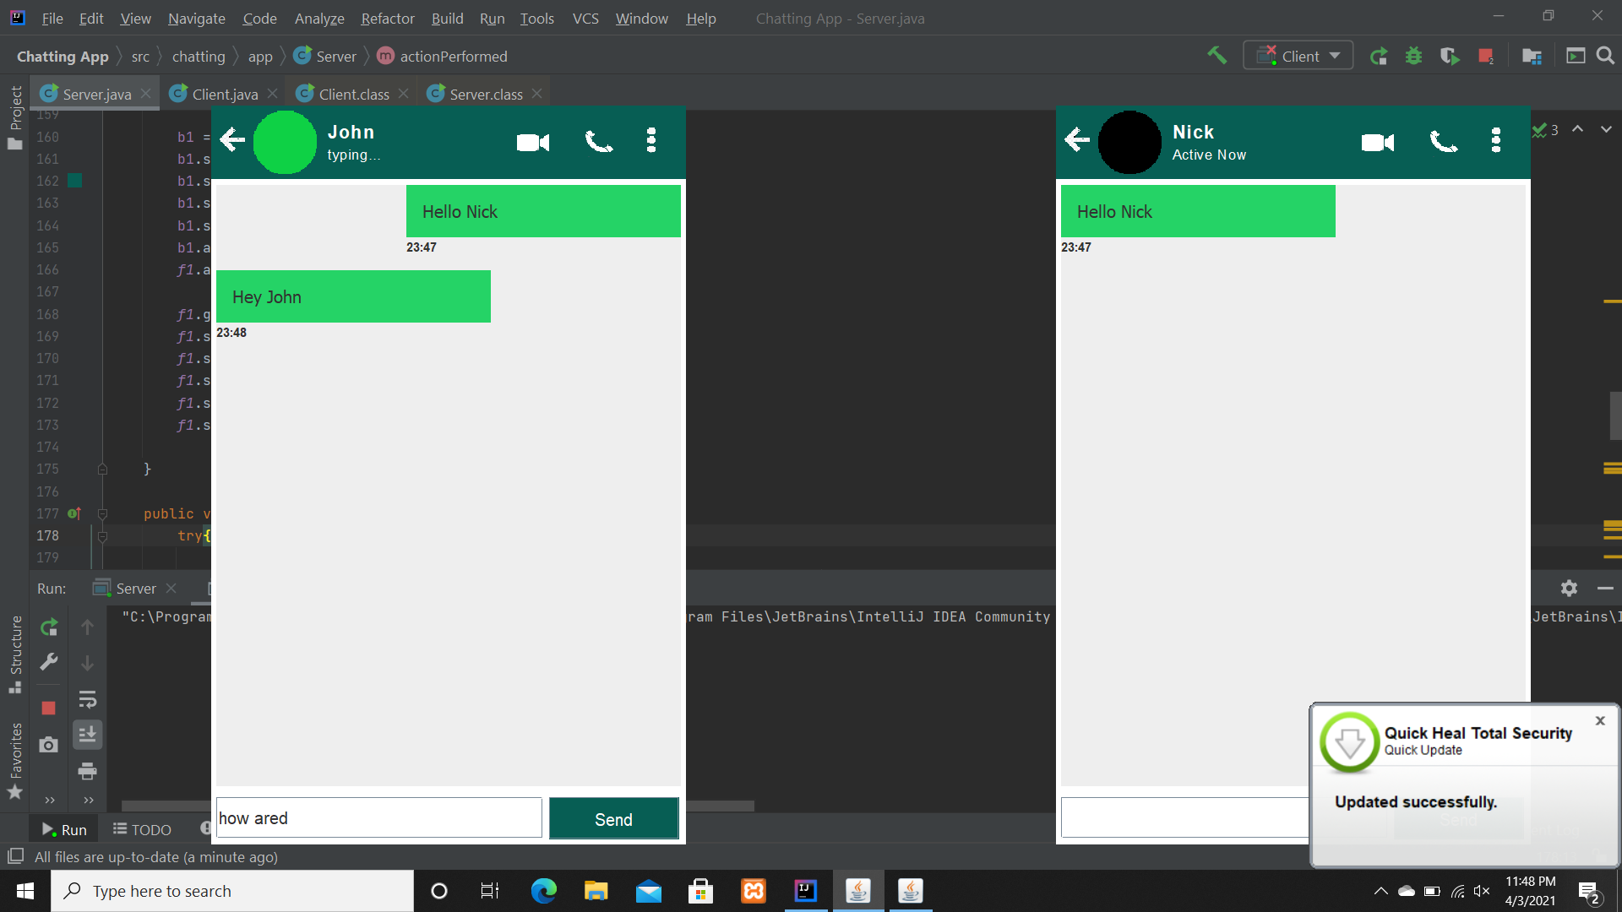
Fig name : The chat between Server and Client

Slide 10
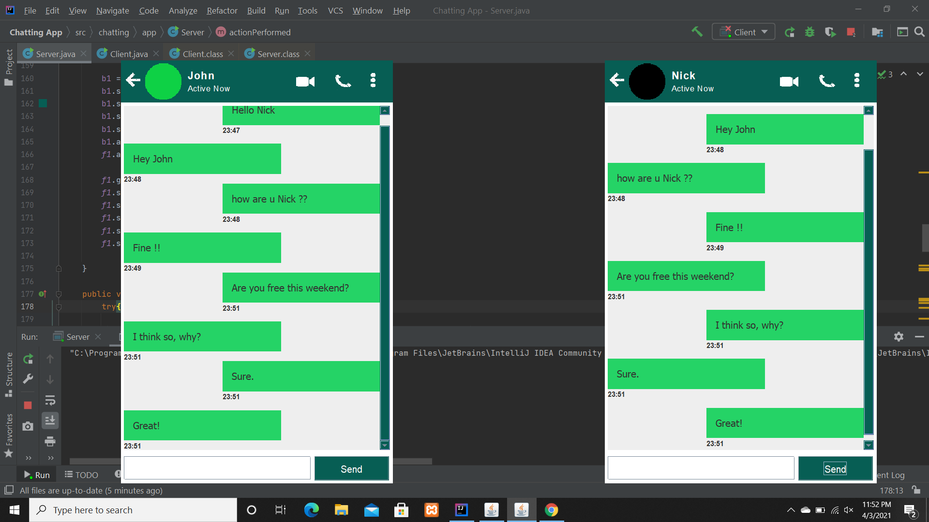
Fig name : The chat between Server and Client

Slide 11
Future Work
There is always a room for improvements in any software package, however good and efficient it may be done. But the most important thing should be flexible to accept further modification. Right now we are just dealing with text communication. In future this software may be extended to include features such as:
File’s transfer
Voice chat
Video chat

Slide 12
Conclusion:
We were successful in creating a adventurous version of Chat Application.
We learned several project management techniques used by professionals to develop a project.

Slide 13
References
YouTube Channel: Code for Interview.
www.stackoverflow.com
www.geekforgeek.com

Slide 14
THANKYOU…!!

